Slide 1

Notes:
Generics enumerators

Slide 2
Show me the code!

Slide 3


Slide 4

Notes:
How do you handle errors that are not controlled by you.

Slide 5
Errors
Exceptions –
Stack Trace (information);
Ability to act upon different types of exceptions;
Create your own exceptions;
Breaks the execution;
Code separation;
Other way -
None
Notes:
What is an exception? What information does it contain

Slide 6
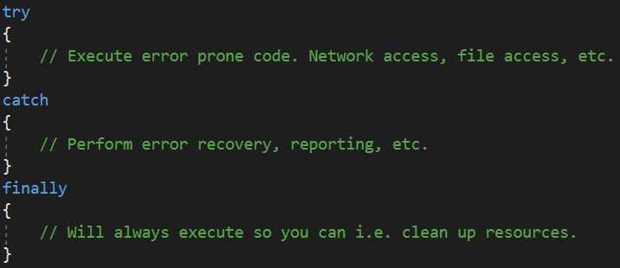
How to handle `em errors?

Slide 7
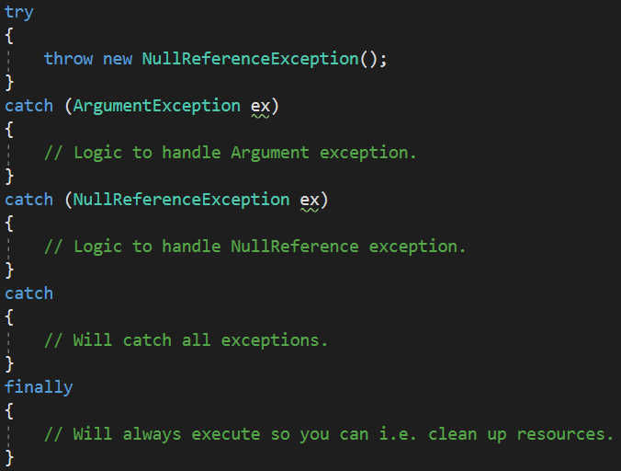
Try, catch, finally

Slide 8
Exceptions example time!

